Slide 1
Khiops 10.2 Khiops & Khiops Visualization Khiops Coclustering & Khiops Covisualization Multi-table functionalities
Orange
November 2023
Tutorial

Slide 2




Khiops
Khiops
Optimal data preparation based on discretization and value grouping
Scoring models for classification and regression
Correlation analysis between pairs of variables
Khiops Visualization
Analysis of Khiops results using an interactive visualization tool
Khiops Coclustering
Correlation analysis of two or more variables using a hierarchical coclustering model
Khiops Covisualization
Exploratory analysis of Khiops Coclustering results using an interactive visualization tool
Multi-table functionalities
Multi-table database
Automatic feature construction
Multi-table functionalities in Khiops and Khiops Coclustering
3
36
60

Slide 3
Khiops & Khiops Visualization
Khiops
Optimal data preparation based on discretization and value grouping
Scoring models for classification and regression
Correlation analysis between pairs of variables
Khiops Visualization
Analysis of Khiops results using an interactive visualization tool

Slide 4
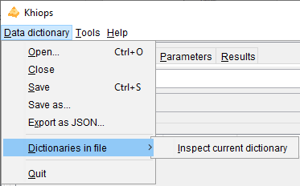
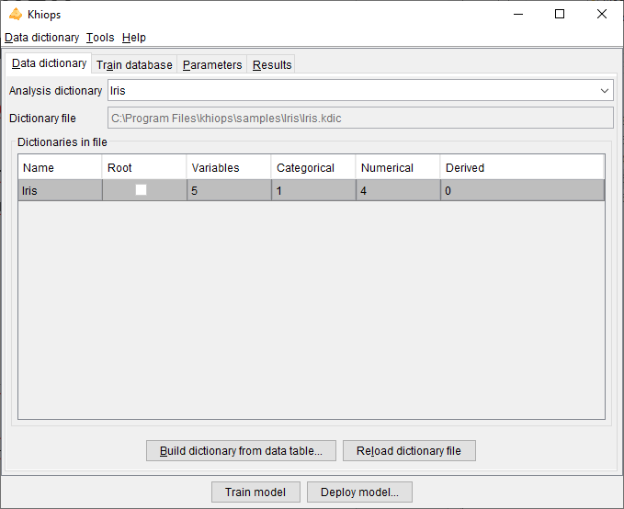
Supervised classification
Step 1 : Open an existing dictionary file
(ex: sample Iris.kdic)
Dictionary file: contains one or more dictionaries
Dictionary: description of variables of a database to use during analysis
Available actions :
Open, Save, Save as, Close
Edition (menu « Dictionary file/Inspect current dictionary », or NotePad)
Build dictionary from data table
Reload dictionary file
useful if it has been modified from an external editor

Slide 5
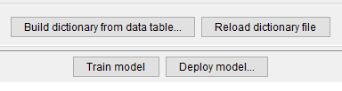
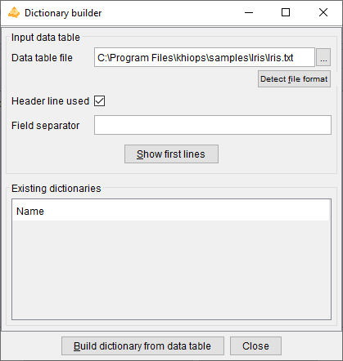
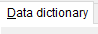
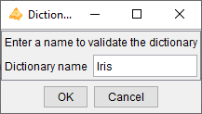
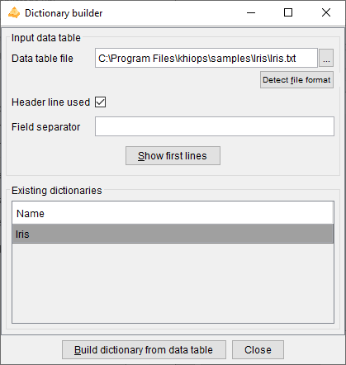
Supervised classification
Step 1, bis : Build a new dictionary from a data table
(If no available dictionary)
1. In pane
Click on button
2. In the dialog box
Specify the data table file
Build the dictionary
3. Specify the dictionary name
Repeat step 2 to build other dictionaries
4. Close to save dictionary file
5. In pane
Inspect the built dictionary
Check variables types
Select used variables

Slide 6
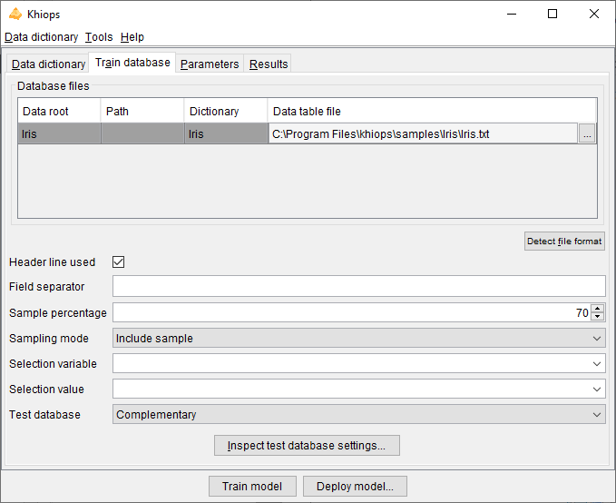
Supervised classification
Step 2 : Specify train database
Detect file format : heuristic help that scans the first few lines to guess the file format. The header line and field separator are updated on success, with a warning or an error in the log window only if necessary.
File Format
Sample percentage : default 70%
Controlled way of selecting the instances by the means of a selection variable and selection value

Slide 7
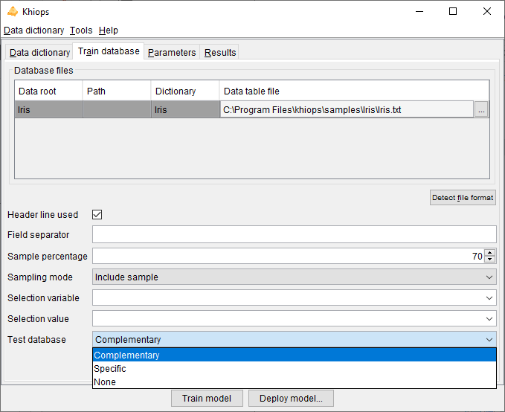
Supervised classification
Step 2, bis : Specify test database
Three possibilities :
Complementary
Specific
None
Complementary (default)
The test database is the complementary of the train database according to the chosen sample percentage

Slide 8
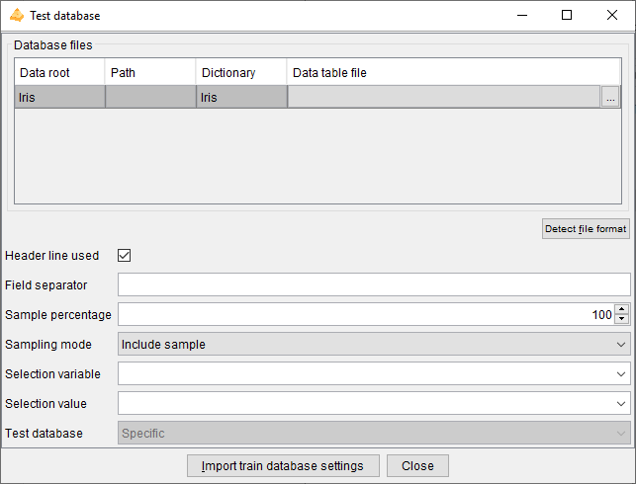
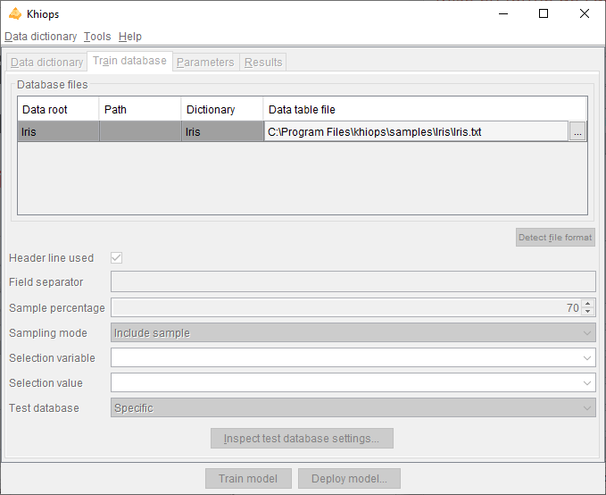
Supervised classification
Step 2, ter : Specify test database
Specific
The test database has it own independent specification : specific file, sampling, selection

Slide 9
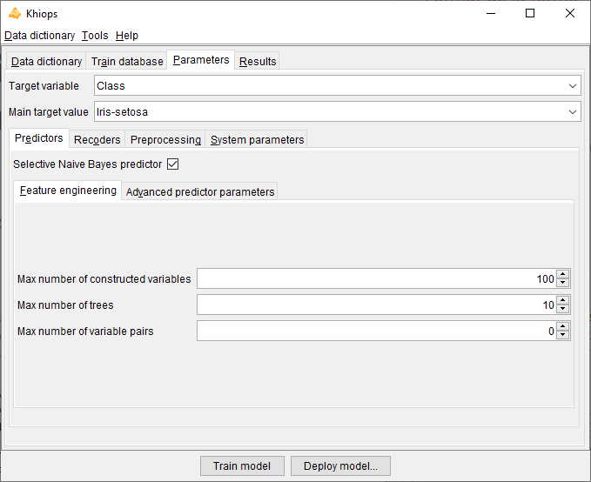
Supervised classification
Step 3 : Parameters
Type of selected target variable implies type of analysis
Categorical -> supervised classification
Numerical -> regression
Empty -> unsupervised analysis
Selective Naïve Bayes predictor
default true, to be set to false if only data preparation is wanted (without modeling)
Constructed variables are computed in multi-table schema and allow to extract numerical or categorical values resulting from computing formula applied to existing variable (default 100)
The constructed trees allow to combine variables, either native or constructed (default 10)
The pairs of variables are analyzed during data preparation using a bivariate discretization method (default 0)

Slide 10
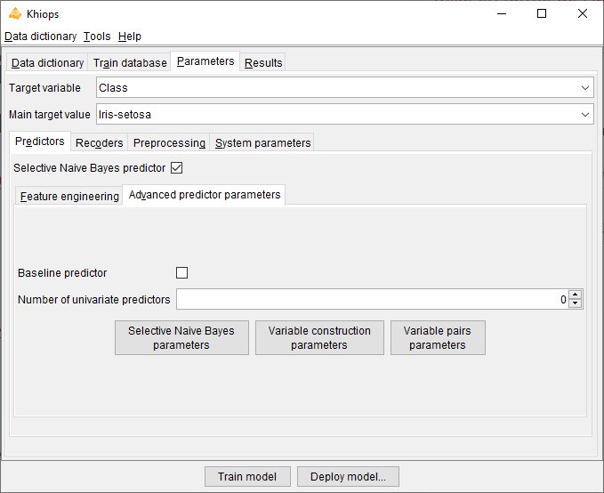
Supervised classification
Step 3 bis : Advanced predictor parameters (optional)
Two other optional predictors
(only in the supervised case)
Baseline : prediction of the majority class
(default false)
Univariate: predictors exploiting one single variable (default none)
Advanced parameters to inspect

Slide 11
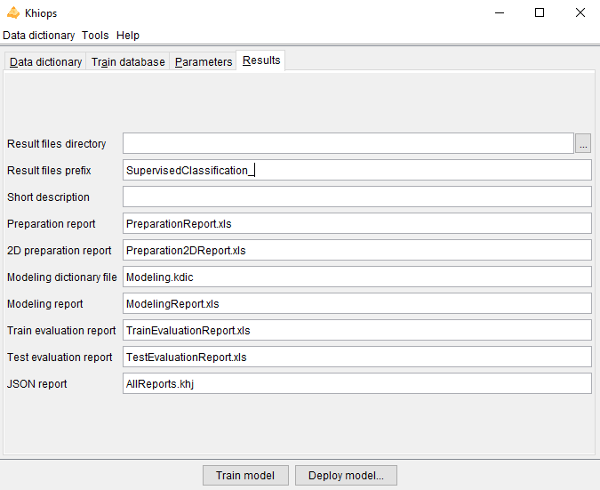
Supervised classification
Step 4 : Results
Directory where all results files are written
Prefix (ex: in case of several experiments)
Brief description to summarize the current analysis
Description of trained univariate preparation models
Description of trained bivariate preparation models
Technical description for deployment purposes
Description of trained models with selected variables
Evaluation on train database
Evaluation on test database
Json report, to get the analysis results from external tools
Fill a prefix

Slide 12
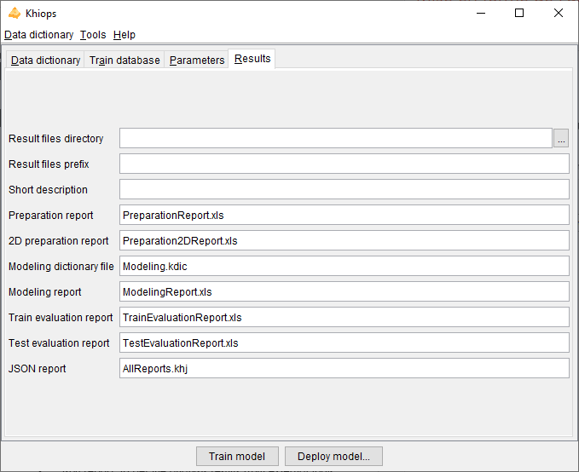
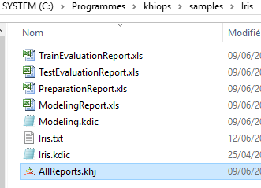
Supervised classification
Step 5 : Start the analysis
2 - Inspect the results using Khiops Visualization
(double-click on .khj file)
1 – Train model

Slide 13
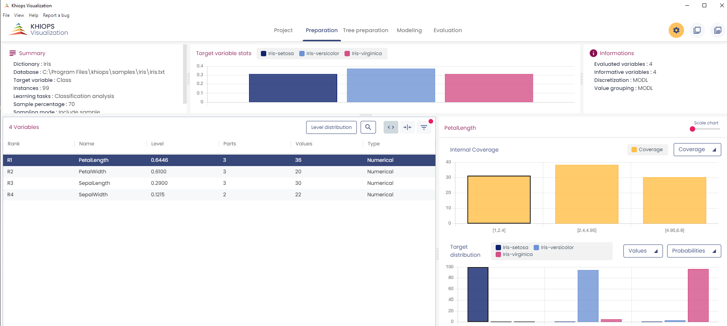
Exploratory of classification results using Khiops Visualization
1 - Preparation
2 - Modeling
3 - Evaluation

Slide 14
Exploratory of classification results using Khiops Visualization
Preparation pane
Coverage of the selected variable
Zoom
Variables
Target distribution of the selected variable

Slide 15
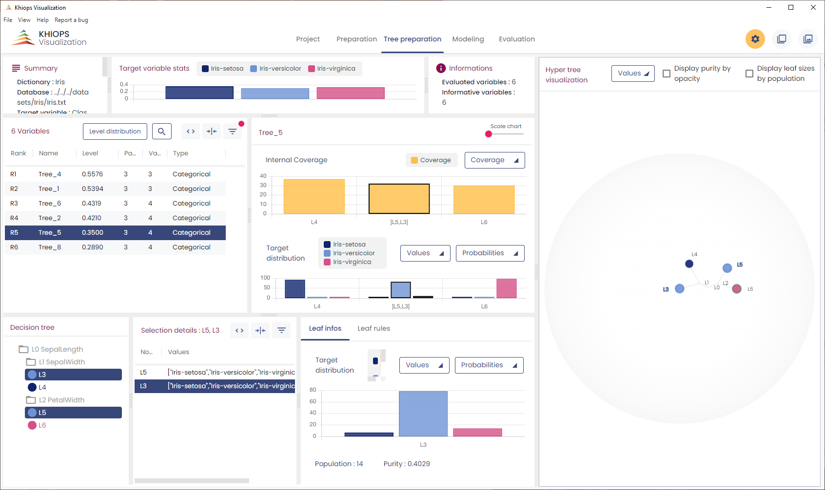
Exploratory of classification results using Khiops Visualization
Tree preparation pane

Slide 16
Exploratory of classification results using Khiops Visualization
Tree preparation pane
General information (as in Preparation pane)
Hypertree of the selected tree
Tree variables and their preparation (as in Preparation pane)
Hierarchy of the selected tree
Information on the selected group of leaves
Information on the selected leaf
- infos: target distribution
- rules: sequence of tree tests

Slide 17
Exploratory of classification results using Khiops Visualization
Tree preparation pane
User click
Multiple selection modes
Everything that is clickable in one panel selects what is relevant in the others

Slide 18
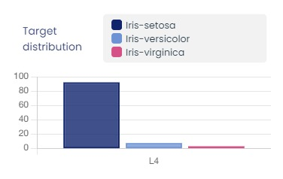
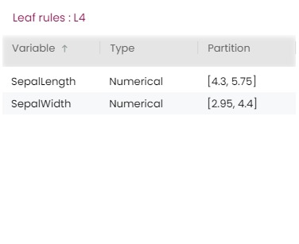
Exploratory of classification results using Khiops Visualization
Tree preparation pane
Information on selected leaf
Leaf infos
Target distribution in leaf
Leaf rules
Sequence of trre rules leading to the leaf

Slide 19
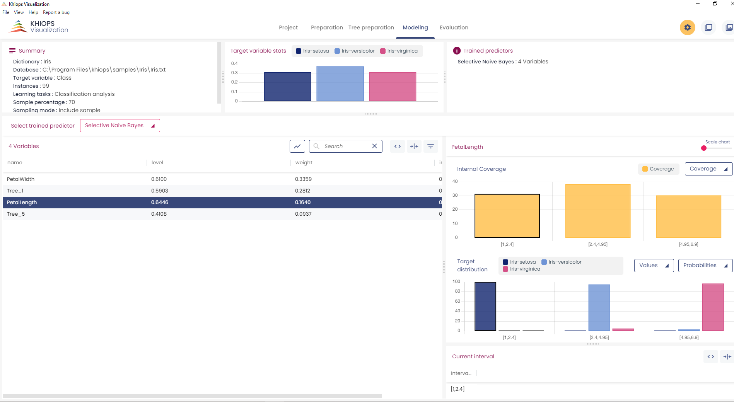
Exploratory of classification results using Khiops Visualization
Modeling pane
Selected predictor
Variables of
the predictor

Slide 20
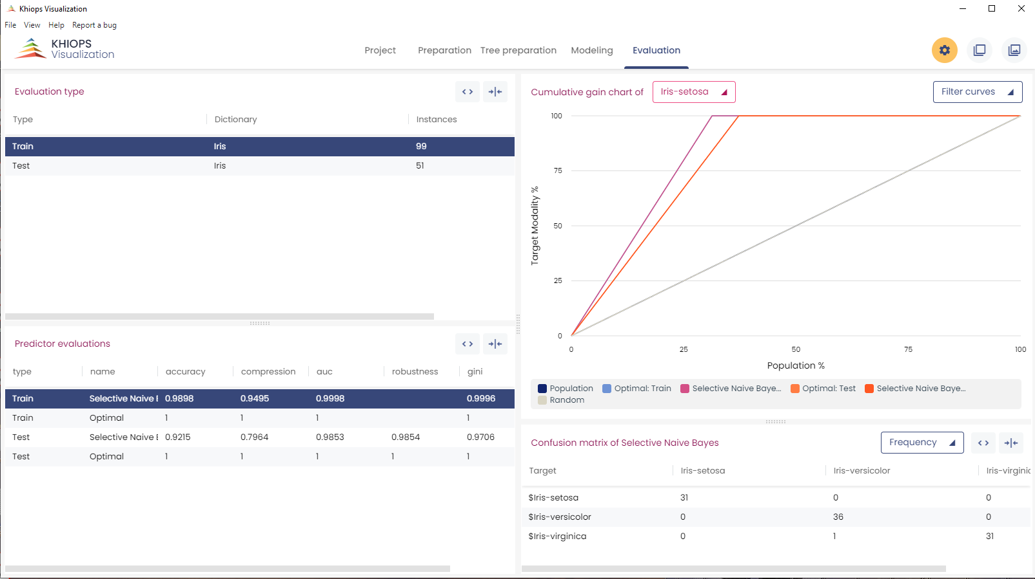
Exploratory of classification results using Khiops Visualization
Evaluation pane
Evaluation list
Cumulative gain charts of each predictor
Predictor
evaluations
Confusion Matrix of the selected predictor

Slide 21
Exercises A and B …
A : Perform a supervised classification on sample database Iris
B : Perform a Supervised classification on sample database Adult
Interpret the analysis results

Slide 22
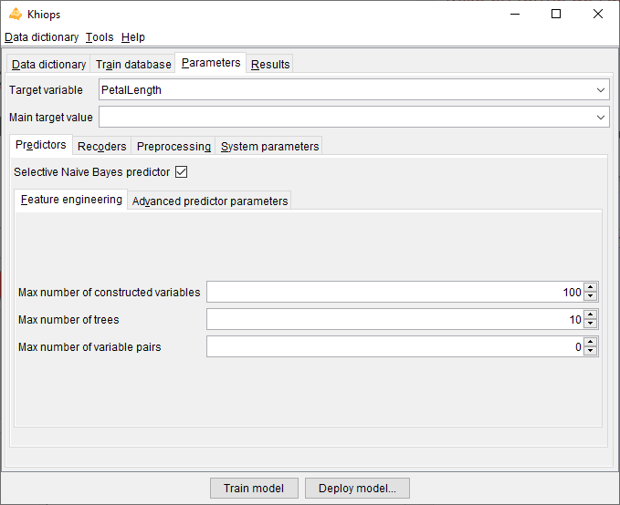

Regression (supervised)
Same as classification
with a numerical target variable
In this case, bivariate analysis and tree construction are not available!

Slide 23
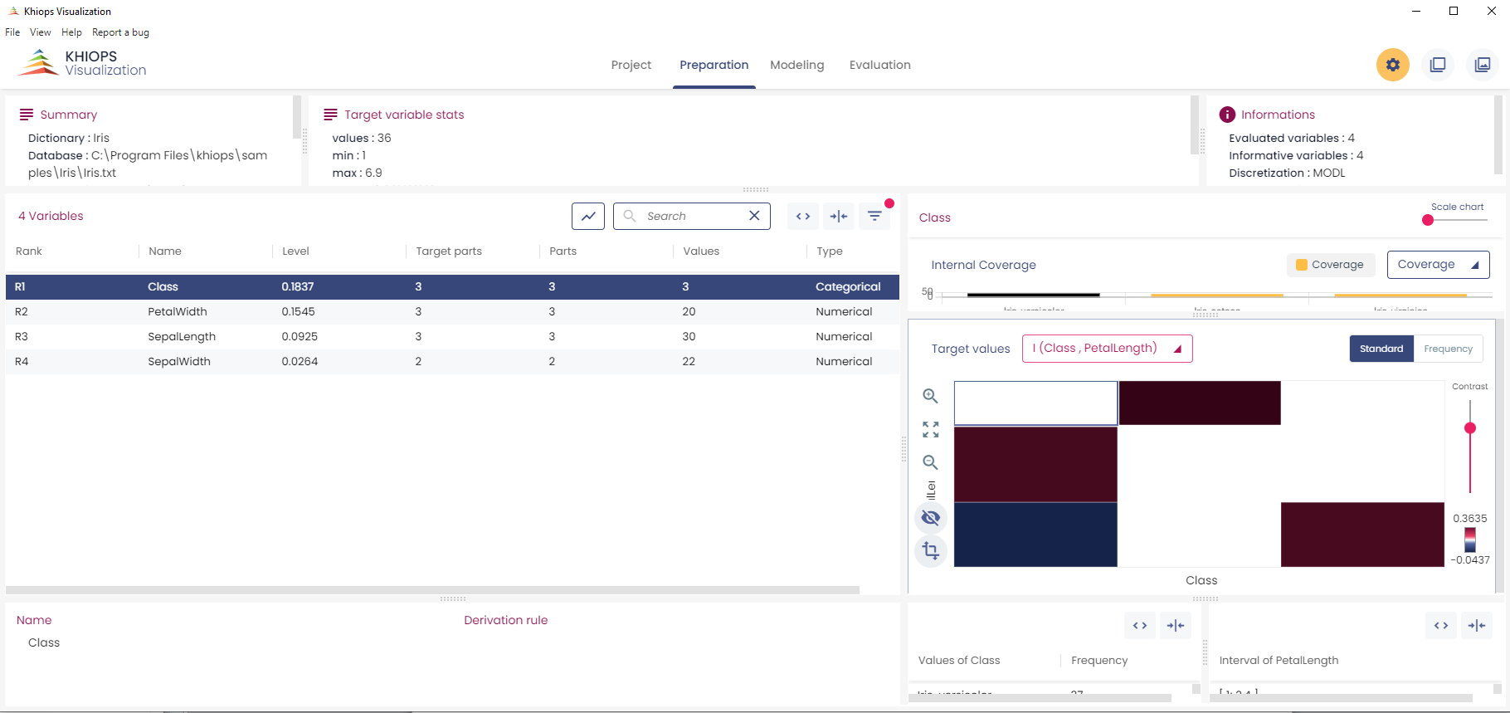
Exploratory of regression results using Khiops Visualization
Co-occurrence matrix of the selected variable vs. the target variable. The color represents mutual information:
In red: cells with frequency higher than expected
In blue: cells with frequency lower than expected

Slide 24
Exercise C …
C : Perform a regression of variable PetalLength of Iris
Interpret the analysis results

Slide 25
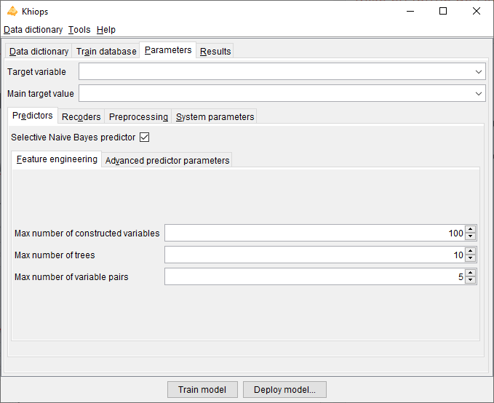
Correlation analysis (unsupervised, bivariate)
Train a correlation model between two variables
(categorical, numerical, both)
1 –Target variable must be empty
2 – Activate bivariate analysis
a – Feature engineering pane
b – Choice of a max number of pairs to analyze

Slide 26
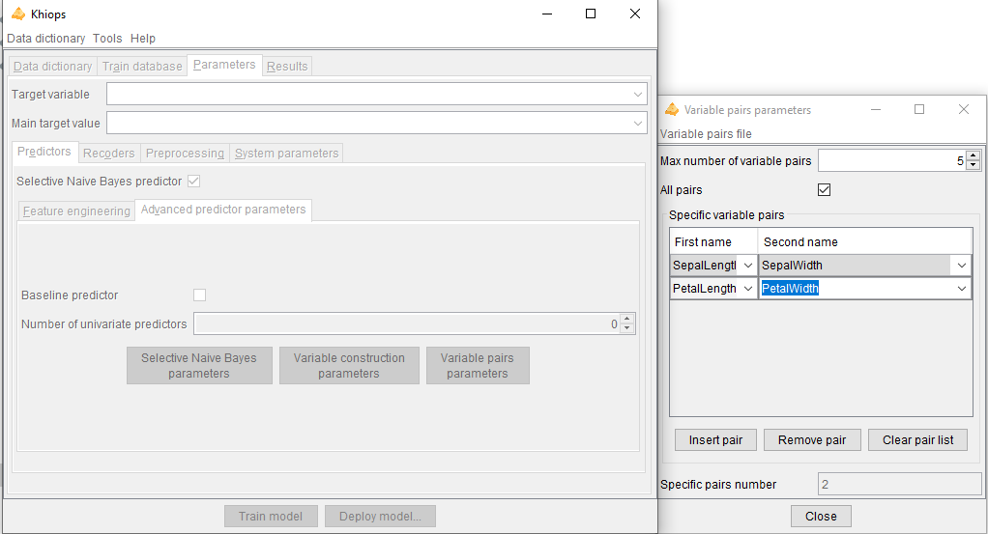
Correlation analysis (unsupervised, bivariate)
Train a correlation model : advanced parameters
1 – Target variable must be empty
2 – Inspect variable pair parameters
3 – Specify the pairs
a – import/export variable pairs file
b - all potential pair
c - individual pairs or families of variable pairs involving certain variables to analyze

Slide 27
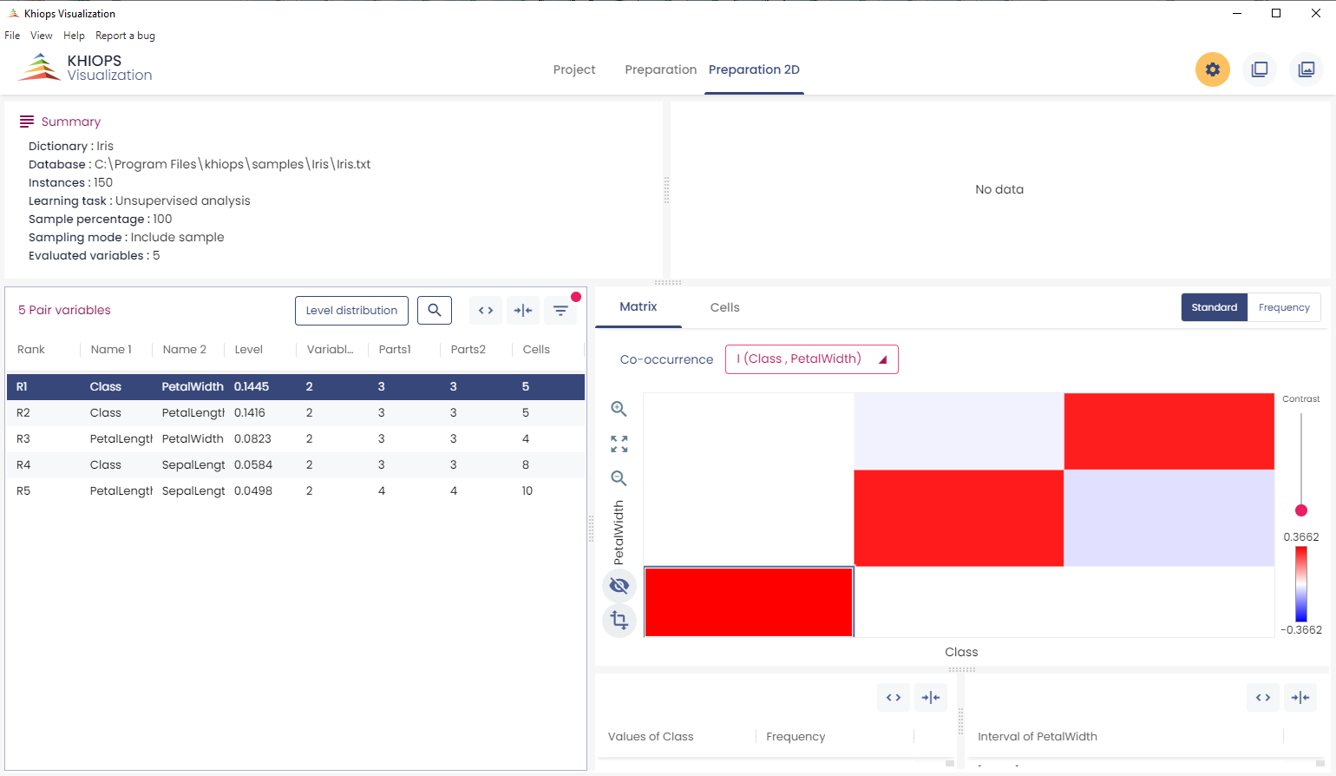
Exploratory of correlation results using Khiops Visualization
Preparation 2D pane
Co-occurrence matrix of the selected variable pair
Variables pairs

Slide 28
Exercises D, E, F and G…
D : Perform the correlation analysis of the two most correlated variables of Iris
(tip: analyze all pairs to identify the most informative)
E : Idem with variables PetalLength and PetalWidth
(tip: inspect the Variable pairs parameters)
F : Idem with new constructed variables PetalArea and SepalArea
(tip: use the derivation rule Product in dictionary,
see KhiopsGuide: sections « Derivation rules » and « Appendix »)
G : Perform the correlation analysis of all pairs of Adult involving variable native_country
Interpret the analysis results

Slide 29
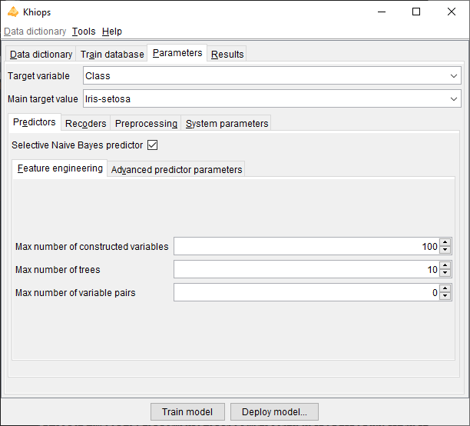
Variable construction
Parameters
Predictors
Feature engineering
Max number of constructed variables
to build an analyze table from a multi-table schema (see later)
automatic extraction of complex information to obtain accurate classifiers
Max number of trees
combines natives or constructed variables to extract complex information
better accuracy, at the expense of interpretability
Max number of pairs of variable
to understand correlation between variables
use rather for exploratory analysis rather than for better accuracy
Recommendation
start with few constructed variables, and increase incrementally
idem for trees
no tree for simpler, faster and more interpretable predictors
more and more trees for more accurate predictors

Slide 30
Exercise H …
A : Perform a supervised classification on sample database Letter
Build 0, 10, 50 trees
Interpret the analysis results, and the trade-off between number of trees, training time and test accuracy

Slide 31
Integration in information systems
Batch mode
to record and replay Khiops scripts
to perform any Khiops task from any programming language
see next slide
Khiops Native Interface (KNI)
dynamic link library (DLL) for online deployment of Khiops models
package to download from https://khiops.org
Python Khiops Library (pykhiops)
to perform any Khiops task from python
to inspect any Khiops analysis results from python
python package available from https://khiops.org
JSON file exports
Khiops dictionaries and analysis results can be exported from the Khiops tool
to exploit Khiops results from any programming language

Slide 32
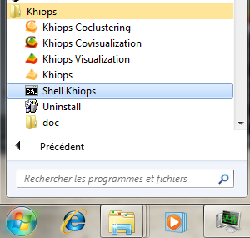
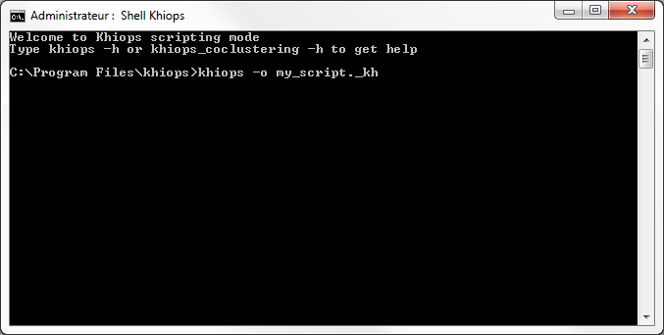
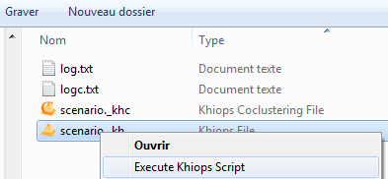
Batch mode
Start a Shell Khiops
Record a script « automatically» using Khiops user interface
khiops –o my_script._kh
o = output
Replay a script from the shell
khiops –i my_script._kh
i = input
Replay a script from Windows Explorer
right click on script file

Slide 33
Exercise I …
I : Record a script file, then replay it …

Slide 34
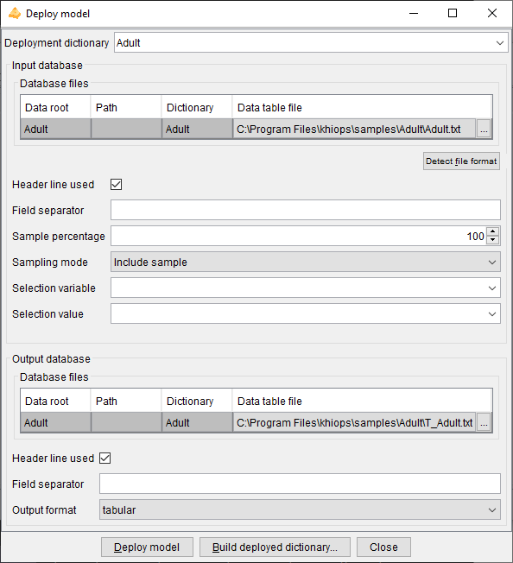
Deploy a model
Steps for model deployment
1- Start from a modeling dictionary « Modeling.kdic »
In « Data dictionary » pane
2- Choose the variables to deploy
Inspect the modeling dictionary In « Data dictionary » pane
by right-click in the “Dictionaries in file” list
Suppress the « Unused » tag from identifier variables
Select the prediction variables to deploy
3- Menu : « Tools -> Deploy model »
4- Deploy model dialog box
Select deployment dictionary
Select input database
Select output database
Click on « Deploy model » button

Slide 35
Exercise J …
J: Deploy a classifier on database Iris

Slide 36
Khiops Coclustering & Khiops Covisualization
Khiops Coclustering
Correlation analysis of two or more variables using a hierarchical coclustering model
Khiops Covisualization
Exploratory analysis of Khiops Coclustering results using an interactive visualization tool

Slide 37
Khiops Coclustering & Khiops Covisualization
Train a coclustering model
Use of Khiops Coclustering back-end tool
Co-partition of two or more categorical or numerical variables
At each level of the hierarchy, the merge of clusters with the minimum information loss is performed
Write results in a coclustering report file « .khcj »
Exploratory analysis of the results
Use of Khiops Covisualization tool
Navigation in the hierarchy of models

Slide 38
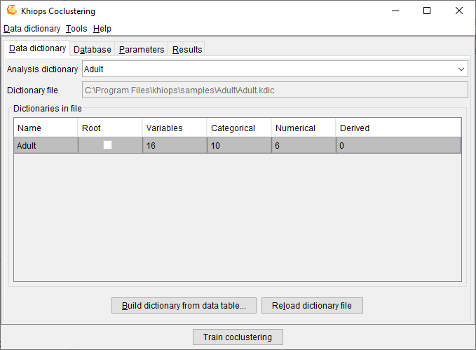
Train a coclustering model
Step 1 : Open an existing dictionary
(ex: sample Adult.kdic)
Description of variables to use during analysis
Available actions :
Open, Save, Save as, Close
Edition (menu « Dictionary file/Inspect current dictionary », or NotePad)
Reload dictionary file
Build dictionary from data table
Dictionary | Adult
{
 | Numerical | Label;
 | Numerical | age;
 | Categorical | workclass;
 | Numerical | fnlwgt;
 | Categorical | education;
 | Numerical | education_num;
 | Categorical | marital_status;
 | Categorical | occupation;
 | Categorical | relationship;
 | Categorical | race;
 | Categorical | sex;
 | Numerical | capital_gain;
 | Numerical | capital_loss;
 | Numerical | hours_per_week;
 | Categorical | native_country;
 | Categorical | class;
};

Slide 39
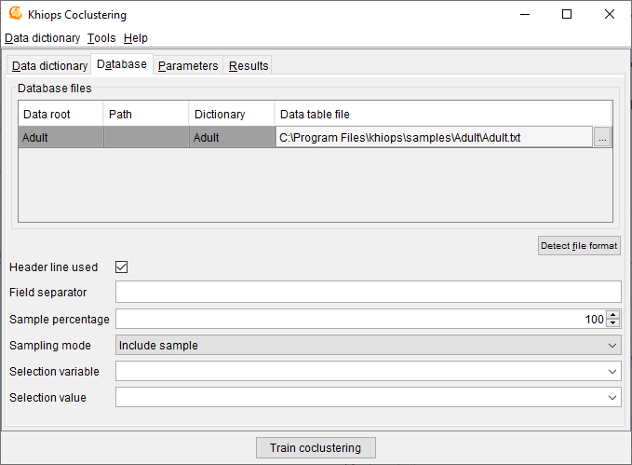
Build a coclustering model
Step 2 : Specification of used database
Detect file format : heuristic help that scans the first few lines to guess the file format. The header line and field separator are updated on success, with a warning or an error in the log window only if necessary.

Slide 40
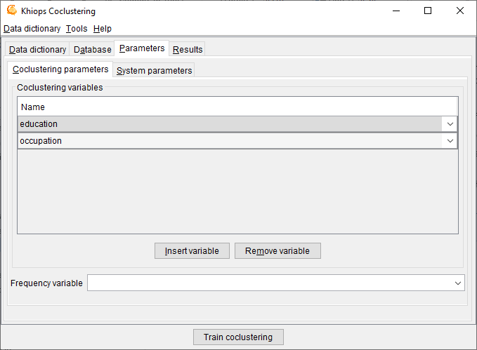
Build a coclustering model
Step 3 : Specification of coclustering variables
Coclustering variables

Slide 41
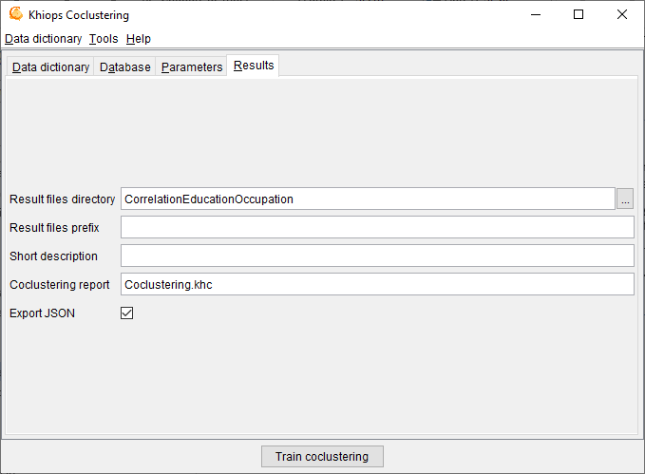
Build a coclustering model
Step 4 : Results
Directory where result file is written
Prefix (ex: in case of several experiments)
Synthetic coclustering report (cf. Khiops Covisualization)
Json report, to get the analysis results from external tools

Slide 42
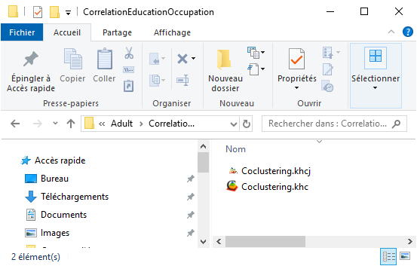
Build a coclustering model
Step 5 : Start the analysis
1 – Train the coclustering
2 - Inspect the results using Khiops Covisualization
(double-click on .khcj file)

Slide 43
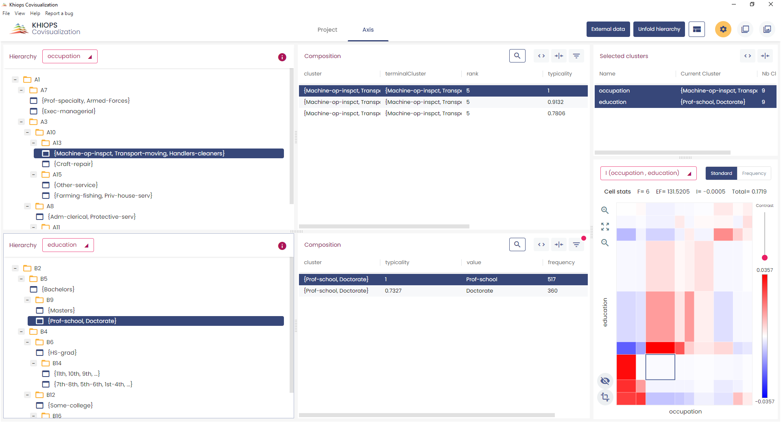
Example: base Adult education*occupation
With Khiops Coclustering
Analysis of pair of variables education*occupation
With Khiops Covisualization
Exploratory analysis of the results

Slide 44
Exercise J …
J : Train a coclustering model
on two categorical variables of sample database Adult
Explore the analysis results

Slide 45

Khiops Covisualization
Interactive hierarchy of variable #1
List of variables
Interactive hierarchy of variable #2

Slide 46
Khiops Covisualization
Composition of selected cluster of variable #1
Composition of selected cluster of variable #2

Slide 47
Khiops Covisualization
Co-occurrence matrix: direct visualization of both partitions jointly. Color represents mutual information :
red: cells with frequency higher than expected
blue: cells with frequency lower than expected

Slide 48
Khiops Covisualization
Unfold Hierarchy allows to choose the coclustering granularity : optimal unfolding of each partition so as to keep the most informative model.

Slide 49
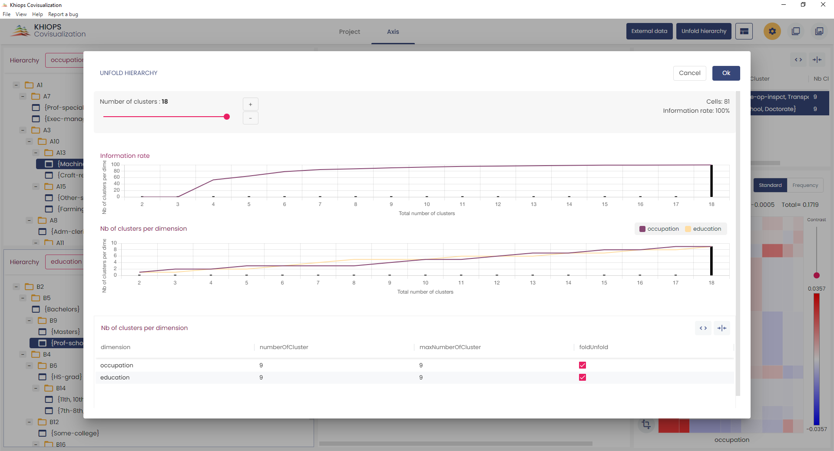
Khiops Covisualization
The evolution of information according to the total number of clusters.
Detailed number of clusters per dimension.

Slide 50
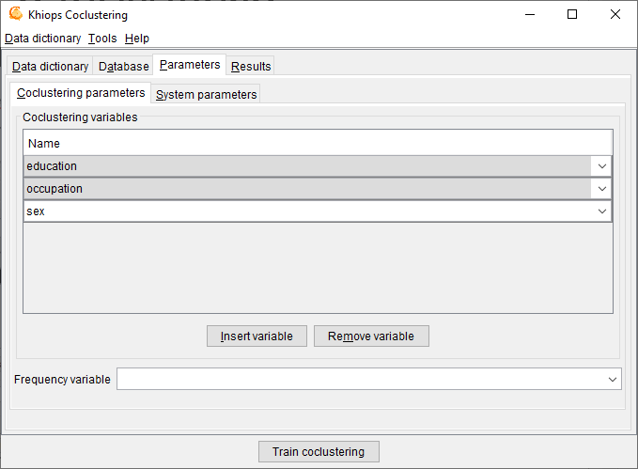
Training a triclustering
Same as coclustering (Step 3) by inserting a third variable
The third variable

Slide 51
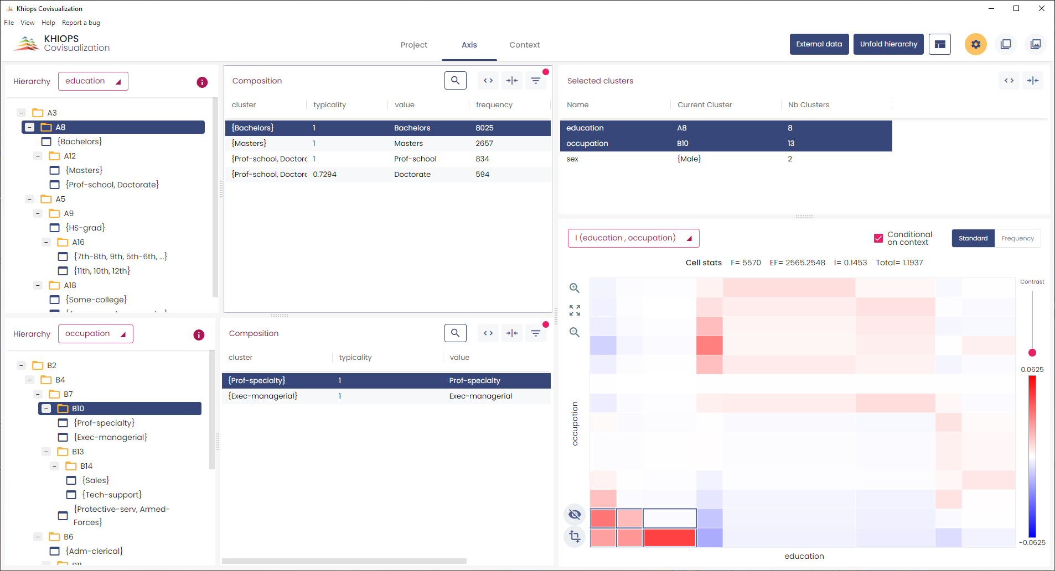
Exploring a triclustering
3 variables (base Adult)
2 main variables

Slide 52
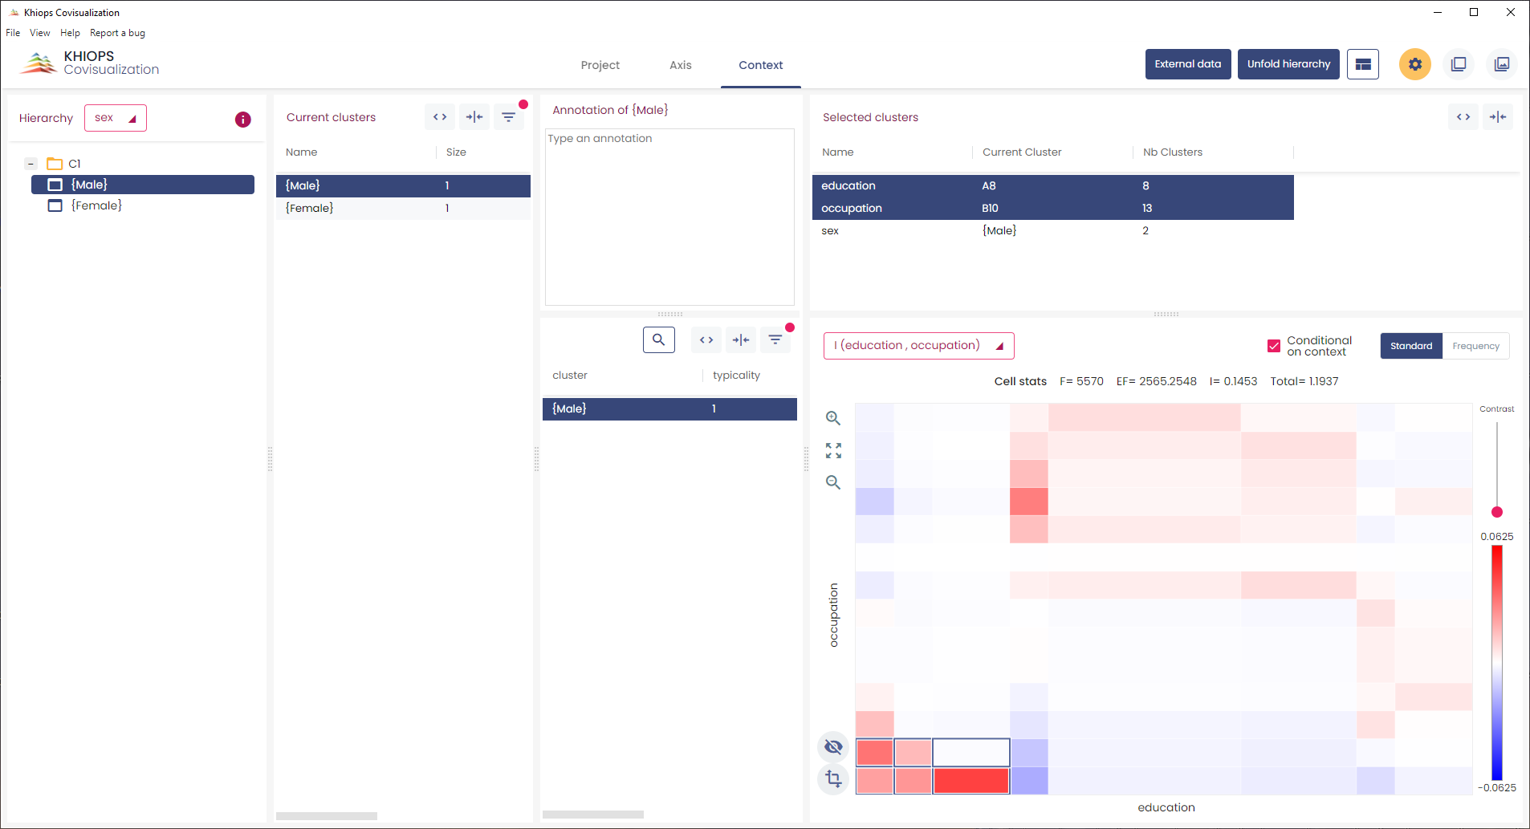
Exploring a triclustering
Context pane

Slide 53
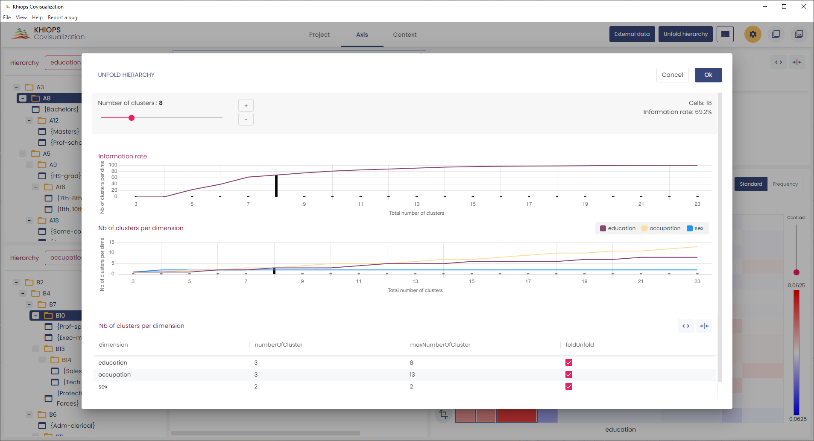
Exploring a triclustering
Choose a hierarchy with 2 X 3 X 3 clusters (with optimal information)

Slide 54
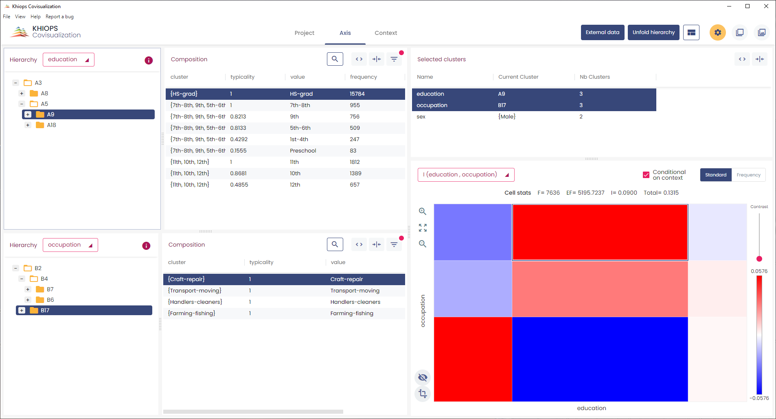
Exploring triclustering
Uneducated men have physical occupations.

Slide 55
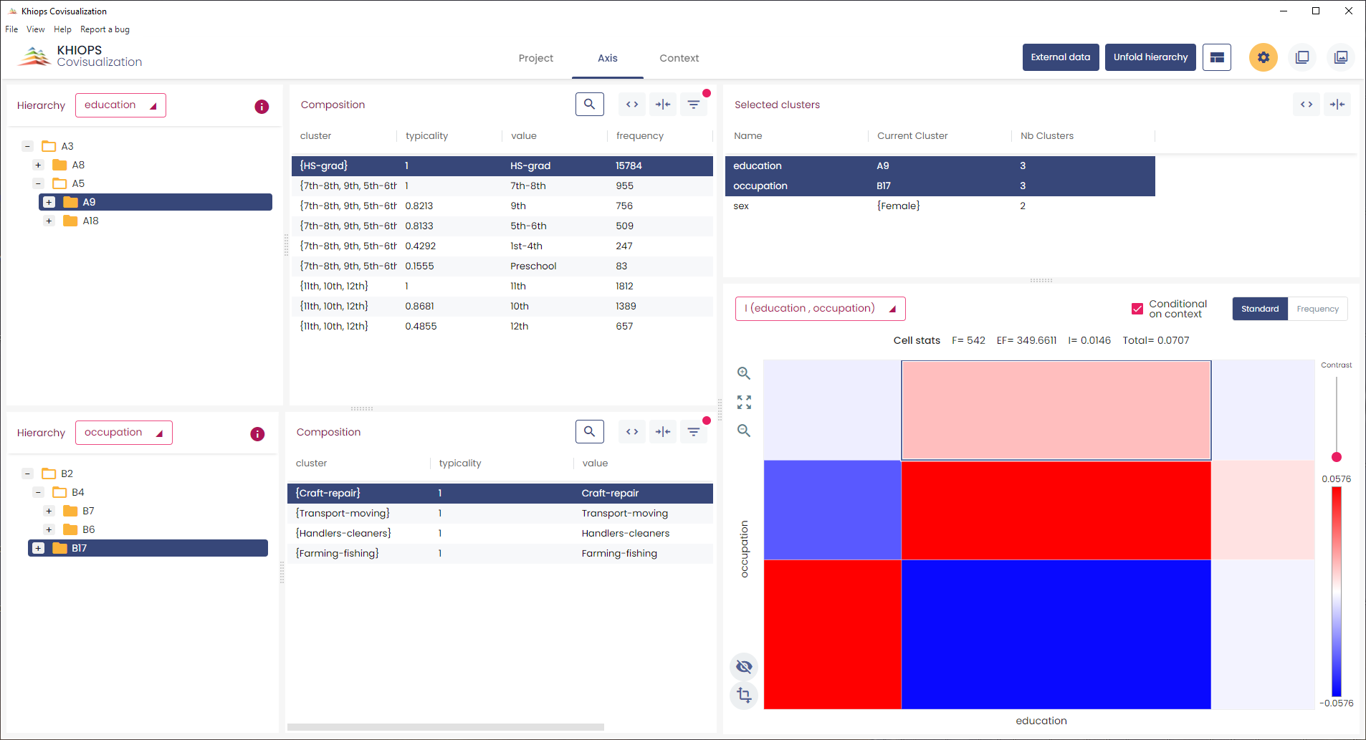
Exploring a triclustering
Uneducated women have service occupations.

Slide 56
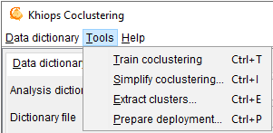
Exploiting a coclustering model
Tools menu
Train coclustering
Input: dictionary and database file
Train a coclustering model
Simplify coclustering
Input: coclustering model
Build a simplify coclustering model given user constraints
Extract clusters
Input: coclustering model
Extract clusters in a text file for a given coclustering variable
Prepare deployment
Input: dictionary and coclustering model
Enables the deployment of a coclustering model on new data by the means of a Khiops deployment dictionary
See multi-table section of the tutorial

Slide 57
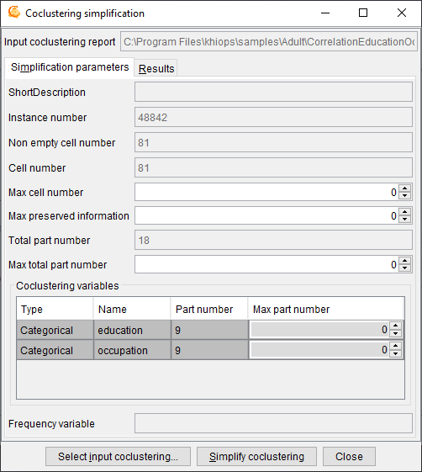
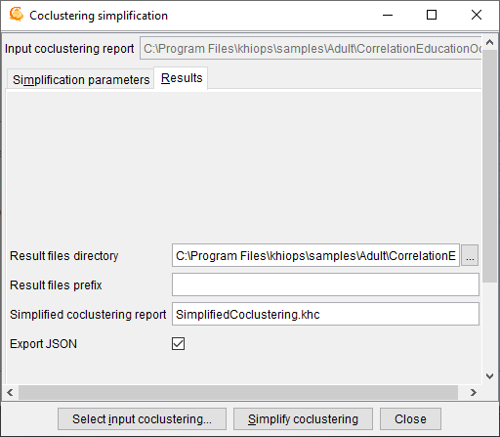
Simplifying a coclustering model
Steps for coclustering model simplification
1- Select input coclustering (.khc)
2- Specify user simplification constraints
Max cell number :
max number of cells to keep in the simplified coclustering
Max preserved information
max percentage of information to keep in the simplified coclustering
Max total part number
max for the sum of the part number per coclustering variable
Per coclustering variables (in the array)
Max part number
max number of part to keep for this variable in the simplified coclustering
(0 : no constraint)
3- Select result files directory
4- Click on « Simplify coclustering »

Slide 58
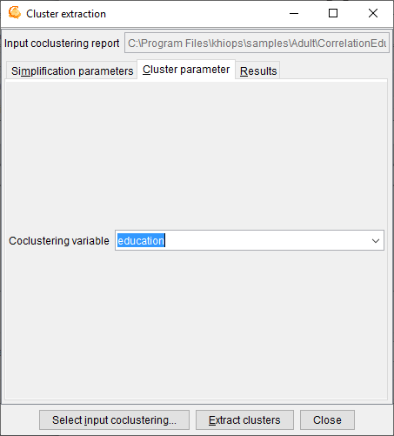
Extracting clusters in a text file
Steps for cluster extraction
1- Select input coclustering (.khc)
2- Specify user simplification constraints
3- Select coclustering variable containing the clusters
4- Select result files directory
5- Click on « Extract clusters »
Output cluster file
Text file with header line and separator tabulation
Columns:
Cluster: name of the cluster (group of values)
Value: name of the value contained in the cluster
Frequency: frequency of the value
Typicality: interest measure of the value within its cluster

Slide 59
Exercise K, L …
K : Simplify previously built adult coclustering model
Keep 50% of the information in the model
L : Extract clusters from variable education of adult coclustering model
Explore the simplified analysis results with Khiops covisualization
Inspect the cluster file with a text editor

Slide 60
Multi-table functionalities
Multi-table functionalities
Multi-table database
Automatic feature construction
Multi-table functionalities in Khiops and Khiops Coclustering

Slide 61
Why extending to multi-table?
Why extending to multi-table?
Most data mining tools work on instances*variables flat tables
Real data often have a structure coming from databases
The input representation is richer using multi-table specification
Data mining methods may benefit from explicit richer domain description
Real data is usually structured
Example
Marketing: Customer with shopping list
Web analytics: cookie with web log
Telecommunications: Customer with call detail records
Bioinformatics: DNA segments with ordered list of nucleotides
…
Data mining with structured data requires a lot of data preparation
Constructing a representation in a flat table
Expert knowledge necessary to constructed new variables
Time expensive process to get a flat table usable for data analysis
This process is unreliable
Risk of missing informative variables
Risk of constructing and selecting irrelevant variables

Slide 62
Khiops multi-table
Khiops can deal with multi-table databases
star schema: one root entity and several 0-1 or 0-n secondary entities
snowflake schemas and beyond
Impact on Khiops
Multi-table dictionary
to describe star-schema input representation
Multi-table database
to store input data on multiple files
Feature construction language
to drive automatic feature construction
Sort functionality on large files
Powerful analytic functionalities
Automatic feature construction
Recoding of multi-table databases to get a flattened representation
Modeling and deployment at the multi-table level
Impact on Khiops Coclustering
Deployment of coclustering models
For example, given a text*word coclustering model, assign new texts to their closest cluster

Slide 63
Khiops multi-table
Khiops can deal with multi-table databases
star schema: one root entity and several 0-1 or 0-n secondary entities
snowflake schemas and beyond
Impact on Khiops
Multi-table dictionary
to describe star-schema input representation
Multi-table database
to store input data on multiple files
Feature construction language
to drive automatic feature construction
Sort functionality on large files
Powerful analytic functionalities
Automatic feature construction
Recoding of multi-table databases to get a flattened representation
Modeling and deployment at the multi-table level
All other Khiops functionalities are available similarly
Classification, regression, correlation analysis
Deployment, recoding, evaluation
…

Slide 64
Khiops multi-table
Khiops can deal with multi-table databases
star schema: one root entity and several 0-1 or 0-n secondary entities
snowflake schemas and beyond
Impact on Khiops
Multi-table dictionary
to describe star-schema input representation
Multi-table database
to store input data on multiple files
Feature construction language
to drive automatic feature construction
Sort functionality on large files
Powerful analytic functionalities
Automatic feature construction
Recoding of multi-table databases to get a flattened representation
Modeling and deployment at the multi-table level
All other Khiops functionalities are available similarly
Classification, regression, correlation analysis
Deployment, recoding, evaluation
…

Slide 65
Star schema
One root entity
secondary tables in 0-1 relationship: Entity
secondary tables in 0-n relationship: Table

Slide 66
Snowflake schema
One root entity
secondary tables in 0-1 relationship: Entity
secondary tables in 0-n relationship: Table
Each table may have secondary tables
Example in samples/Customer
detailed explanations in sample

Slide 67
External tables
One root entity
secondary tables in 0-1 relationship: Entity
secondary tables in 0-n relationship: Table
Each table can have secondary tables
External tables
to reuse common table shared by all analysis entities
can be referenced from any table, with specific keys
Example in samples/CustomerExtended
detailed explanations in sample

Slide 68
Multi-table schemas: synthesis
Khiops 8.0:
from mono-table to star schema
Automatic variable construction
a technological disruption
Khiops 9.0:
extended data schema
Snowflake schema
External data
Multiple snowflake schema

Slide 69
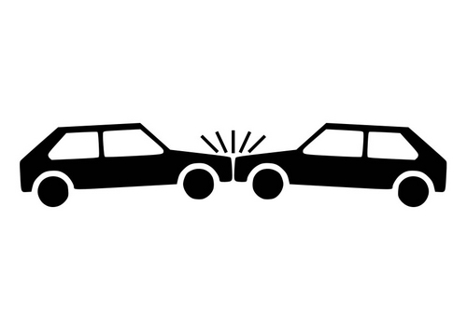
Example of a multi-table database
French road accidents database
The AccidentsSummary is described using the following star schema:
Accident
|
| -- 1:n -- Vehicle
Each accident has associated one or more vehicles. In the Khiops dictionary Accident-Vehicle 1:n relationship is described with the Table keyword. The key linking both tables is AccidentId.
Objective: predict fatal traffic accidents (target variable: Gravity field of Accident table)

Slide 70





Build a multi-table dictionary
Step 1: Build one dictionary per data table
a : Build the first dictionary for the Accidents.txt table
1. In pane
Click on button Build dictionary…
2. Build the first dictionary
Specify the data table file: Accidents.txt
Build the dictionary
Specify the dictionary name : Accident

Slide 71

Build a multi-table dictionary
Step 1: Build one dictionary per data table
b : Repeat for the Vehicles.txt table

Slide 72


Build a multi-table dictionary
Step 1: save the constructed dictionary into a .kdic file
4. Save in dictionary file
Close
Specify the dictionary file name: AccidentsTutorial.kdic
Save

Slide 73
Build a multi-table dictionary
Step 2: Describe the table relationships in the .kdic file
5. Open the dictionary file
with a text editor
5.1 Specify the root entity
5.2 Fix the types of the fields in green
5.4 Specify the relation between
the root entity and the secondary entity
Add a variable per relation to root dictionary
Table for 0-n relationship
Entity for 0-1 relationship
6. Save the dictionary file
Root Dictionary Accident(AccidentId)
{
Categorical AccidentId;
Categorical Gravity;
Date Date;
Time Hour;
Categorical Light;
Categorical Department;
Categorical Commune;
Categorical InAgglomeration;
Categorical IntersectionType;
Categorical Weather;
Categorical CollisionType;
Categorical PostalAddress;
Table(Vehicle) Vehicles;
};
Dictionary Vehicle(AccidentId, VehicleId)
{
Categorical AccidentId;
Categorical VehicleId;
Categorical Direction;
Categorical Category;
Numerical PassengerNumber;
Categorical FixedObstacle;
Categorical MobileObstacle;
Categorical ImpactPoint;
Categorical Maneuver;
};
5.3 Specify the key fields
for each entity
Key fields must be Categorical
and not derived

Slide 74


Sort data table files (if necessary)
For multi-table analyses data table files must be sorted by their keys
Sorting is done only once before any Khiops analysis
Note: Records of the root table must be unique by key
It is necessary for efficiency, specially when treating large databases
Records of the root and secondary tables are read synchronously from their data table files
1. Open the multi-table dictionary file
This allows to obtain the definition of the tables to sort
2. Menu: Tools → Sort data table by key
In the Data table sorter window, for each data table to sort
2.1 Specify the sort dictionary
2.2 Specify the sort variables
Default key variables to use the keys defined in dictionary
2.3 Specify the input and output data table files
2.4 Sort
The output file is sorted by key
All native variables are kept (used or not in the dictionary)
Derived variables are ignored

Slide 75

Supervised classification
Step 1, bis : Open the Accidents.kdic dictionary file
Analysis dictionary
Root entity
Secondary entity

Slide 76

Supervised classification
Step 2 : Specify train and test databases
Specify the root and secondary data table files
Root data table files
Secondary data table file

Slide 77

Supervised classification
Step 3 : Parameters
Target variable
Main target value

Slide 78

Supervised classification
Step 4 : Variable construction parameters
Optional
Choice of construction rules

Slide 79

Supervised classification
Step 5 : Analysis results
Results files directory

Slide 80

Supervised classification
Step 6 : Start the analysis
1 - Train model
2 - Inspect the results using Khiops Visualization
(double-click on .khj file)

Slide 81

Exploratory of classification results using Khiops Visualization
Preparation
Constructed variable name
Constructed variable
derivation rule

Slide 82


Example of a complex multi-table database
French road accidents database (full version)
This the full version of the AccidentsSummary dataset.
It is described using the following snowflake schema:
Accident
|
| -- 1:n -- Vehicle
| |
| |-- 1:n -- User
|
| -- 1:1 –- Place
Each accident has associated one or more vehicles and one unique place. The vehicles involved in an accident have in turn associated one or more road users (passengers and pedestrians).
In the Khiops dictionary the Accident-Place relationship (1:1) is described with the Entity keyword, whereas the Accident-Vehicle and Vehicle-User relationships (1:n) with the Table keyword.
Objective: predict fatal traffic accidents (target variable: Gravity field of Accident table)

Slide 83

Supervised classification
Step 1 : Open the Accidents.kdic dictionary file
Analysis dictionary
Root entity
Secondary entities

Slide 84

Supervised classification
Step 2 : Specify train and test databases
Root and other data table files have to be specified
Root data table files
Secondary data table files

Slide 85

Supervised classification
Step 3 : Parameters
Target variable
Main target value

Slide 86

Supervised classification
Step 4 : Variable construction parameters
Optional
Choice of construction rules

Slide 87

Supervised classification
Step 4 : Variable construction parameters
Optional
Choice of construction rules

Slide 88
Supervised classification
Step 5 : Analysis results
Results files directory

Slide 89

Supervised classification
Step 6 : Start the analysis
1 - Train model
2 - Inspect the results using Khiops Visualization
(double-click on .khj file)

Slide 90

Exploratory of classification results using Khiops Visualization
Preparation
Constructed variable name
Constructed variable
derivation rule

Slide 91
Khiops multi-table
Khiops can deal with multi-table databases
star schema: one root entity and several 0-1 or 0-n secondary entities
snowflake schemas and beyond
Impact on Khiops Coclustering
Deployment of coclustering models
Given a text*word coclustering model, assign new texts (with their words) to their closest cluster
Given a cookie*page coclustering model, assign new cookies (with their pages) to their closest cluster
Given a curve*X*Y triclustering model, assign new curves (with their X*Y points) to their closest cluster
In this tutorial
Build a triclustering model on the SpliceJunctionDNA data table
Clusters of sequence samples
Intervals of positions in the sequences
Clusters of DNA chars
Prepare a deployment model
Build a deployment dictionary
Deploy the model on the multi-table SpliceJunction database
Assign new DNA sequences to trained clusters of sequences

Slide 92

Splice junction multi-table database
Molecular Biology (Splice-junction Gene Sequences)
Objective:
Recognition of boundaries between exons and introns in DNA sequences
Splice junctions are points on a DNA sequence at which `superfluous' DNA is removed during the process of protein creation in higher organisms. The problem posed in this dataset is to recognize, given a sequence of DNA, the boundaries between exons (the parts of the DNA sequence retained after splicing) and introns (the parts of the DNA sequence that are spliced out). This problem consists of two subtasks: recognizing exon/intron boundaries (referred to as EI sites), and recognizing intron/exon boundaries (IE sites). (In the biological community, IE borders are referred to as ``acceptors'' while EI borders are referred to as ``donors''.)
Database dictionary
Root entity: splice junction
SampleId
Class (EI, IE, NEG)
Sequence of DNA
Secondary entity: DNA
SampleId:
Pos: position in the sequence
Char (A, C, G, T)
Database files
SpliceJunction.txt
SpliceJunctionDNA.txt
SpliceJunction.txt
SpliceJunctionDNA.txt
SampleId | Class
AGMKPNRSB-NEG-1 | N
AGMORS12A-NEG-181 | N
AGMORS9A-NEG-481 | N
AGMRSKPNI-NEG-1141 | N
ATRINS-ACCEPTOR-1678 | IE
ATRINS-ACCEPTOR-701 | IE
ATRINS-DONOR-521 | EI
ATRINS-DONOR-905 | EI
…
SampleId | Pos | Char
AGMKPNRSB-NEG-1 | 1 | C
AGMKPNRSB-NEG-1 | 2 | A
…
AGMKPNRSB-NEG-1 | 58 | A
AGMKPNRSB-NEG-1 | 59 | C
AGMKPNRSB-NEG-1 | 60 | A
AGMORS12A-NEG-181 | 1 | A
AGMORS12A-NEG-181 | 2 | G
…
AGMORS12A-NEG-181 | 59 | G
AGMORS12A-NEG-181 | 60 | G
AGMORS9A-NEG-481 | 1 | T
AGMORS9A-NEG-481 | 2 | G
AGMORS9A-NEG-481 | 3 | G
…
Exploratory analysis of DNA sequences:
. find clusters of similar DNA sequences
. using a triclustering SampleId x Pos x Char

Slide 93

Train a triclustering model
Step 1 : Open an existing dictionary
(ex: sample SpliceJunction.kdic)
Analysis dictionary (secondary entity)

Slide 94

Train a triclustering model
Step 2 : Specification of used database
Data table file
(one single file for analysis of the secondary entity)

Slide 95

Train a triclustering model
Step 3 : Specification of triclustering variables
Triclustering variables

Slide 96

Train a triclustering model
Step 4 : Analysis results
Result files directory

Slide 97

Train a triclustering model
Step 5 : Start the analysis
1 – Start the analysis
2 - Inspect the results using Khiops Covisualization
(double-click on .khcj file)

Slide 98

Khiops covisualisation: base SpliceJunctionDNA
With Khiops Coclustering
Analysis of correlation between variables SampleId*Pos*Char
With Khiops Covisualization
Exploratory analysis of the results

Slide 99
Khiops multi-table
Khiops can deal with multi-table databases
star schema: one root entity and several 0-1 or 0-n secondary entities
snowflake schemas and beyond
Impact on Khiops Coclustering
Deployment of coclustering models
Given a text*word coclustering model, assign new texts (with their words) to their closest cluster
Given a cookie*page coclustering model, assign new cookies (with their pages) to their closest cluster
Given a curve*X*Y triclustering model, assign new curves (with their X*Y points) to their closest cluster
In this tutorial
Train a triclustering model on the SpliceJunctionDNA data table
Clusters of sequence samples
Intervals of positions in the sequences
Clusters of DNA chars
Prepare a deployment model
Build a deployment dictionary
Deploy the model on the multi-table SpliceJunction database
Assign new DNA sequences to trained clusters of sequences

Slide 100
Prepare a deployment model
Prerequisite : a multi-table database
dictionary file
data files
(ex: sample SpliceJunction)
Root entity
for deployment on new instances
Secondary entity
previously analyzed using triclustering
SpliceJunction.kdic
SpliceJunction.txt
SpliceJunctionDNA.txt
Root Dictionary SpliceJunction(SampleId)
{
Categorical SampleId ;
Categorical Class;
Table(SpliceJunctionDNA) DNA;
};
Dictionary SpliceJunctionDNA(SampleId)
{
Categorical SampleId ;
Numerical Pos;
Categorical Char;
};
SampleId | Class
AGMKPNRSB-NEG-1 | N
AGMORS12A-NEG-181 | N
AGMORS9A-NEG-481 | N
AGMRSKPNI-NEG-1141 | N
ATRINS-ACCEPTOR-1678 | IE
ATRINS-ACCEPTOR-701 | IE
ATRINS-DONOR-521 | EI
ATRINS-DONOR-905 | EI
…
SampleId | Pos | Char
AGMKPNRSB-NEG-1 | 1 | C
AGMKPNRSB-NEG-1 | 2 | A
…
AGMKPNRSB-NEG-1 | 58 | A
AGMKPNRSB-NEG-1 | 59 | C
AGMKPNRSB-NEG-1 | 60 | A
AGMORS12A-NEG-181 | 1 | A
AGMORS12A-NEG-181 | 2 | G
…
AGMORS12A-NEG-181 | 59 | G
AGMORS12A-NEG-181 | 60 | G
AGMORS9A-NEG-481 | 1 | T
AGMORS9A-NEG-481 | 2 | G
AGMORS9A-NEG-481 | 3 | G
…

Slide 101

Prepare a deployment model
Step 1 : Open an existing dictionary
(ex: sample SpliceJunction.kdic)
Root entity
for deployment on new instances
Secondary entity
previously analyzed using triclustering

Slide 102

Prepare a deployment model
Step 2 : Start « Tools – Prepare deployment »

Slide 103


Prepare a deployment model
Step 3 : Select input coclustering file
(ex: previously trained triclustering model)
click on button
select a triclustering model file
open

Slide 104

Prepare a deployment model
Step 4 : The triclustering model is summarized in the first pane
if necessary, specify simplification parameters
Simplification parameters

Slide 105

Prepare a deployment model
Step 5 : Specify deployment parameters
Specification of input dictionary to enrich
Specification of deployment variables to build
Root Dictionary SpliceJunction(SampleId)
{
Categorical SampleId ;
Categorical Class;
Table(SpliceJunctionDNA) DNA;
};
Dictionary SpliceJunctionDNA(SampleId)
{
Categorical SampleId ;
Numerical Pos;
Categorical Char;
};
. One variable to assign closest cluster
. closest cluster of SampleId
. Several variables for distance to each cluster
. distance to each cluster of SampleId
. Several variables for secondary record number per interval/group of the other dimensions of the triclustering
. frequency per interval of Pos
. frequency per group of Char

Slide 106

Prepare a deployment model
Step 6 : Specify result parameters
Result files directory
Deployment dictionary file
(to deploy cluster information on new data)

Slide 107

Prepare a deployment model
Step 7 : Build the deployment dictionary
1 – Build the deployment dictionary
2 – The deployment dictionary is ready for use with Khiops « Transfer database » functionality

Slide 108
Khiops multi-table
Khiops can deal with multi-table databases
star schema: one root entity and several 0-1 or 0-n secondary entities
snowflake schemas and beyond
Impact on Khiops Coclustering
Deployment of coclustering models
Given a text*word coclustering model, assign new texts (with their words) to their closest cluster
Given a cookie*page coclustering model, assign new cookies (with their pages) to their closest cluster
Given a curve*X*Y triclustering model, assign new curves (with their X*Y points) to their closest cluster
In this tutorial
Train a triclustering model on the SpliceJunctionDNA data table
Clusters of sequence samples
Intervals of positions in the sequences
Clusters of DNA chars
Prepare a deployment model
Build a deployment dictionary
Deploy the model on the multi-table SpliceJunction database
Assign new DNA sequences to trained clusters of sequences

Slide 109

Deploy the model
Step 1 : Open the deployment dictionary file with Khiops
(ex: Samples\SpliceJunction\TriclusteringResults\Deployment\Coclustering.kdic)
Deployment dictionary
Root entity
Secondary entity

Slide 110

Deploy the model
Step 2 : If necessary, select deployment variables
(use « Inspect current dictionary » by right-click on dictionary SpliceJunction)
Initial variables
Used by default
Model variables
(technical variables)
Deployment variables
Cluster index (unused by default)
Cluster label (used by default)

Slide 111
Deploy the model
Step 3 : Open the « Deploy model » dialog box
click on button

Slide 112

Deploy the model
Step 4 : Specify the file transfer parameters
1 Specify the deployment dictionary
2 Specify the input data table files
splice junction samples with their DNA sequence
all files are mandatory
3 Specify the output data table files
secondary files are optional
4 Deploy
The output files are enriched with new fields derived from the triclustering analysis

Slide 113
End of tutorial: summary
Khiops
Optimal data preparation based on discretization and value grouping
Scoring models for classification and regression
Correlation analysis between pairs of variables
Khiops Visualization
Analysis of Khiops results using an interactive visualization tool
Khiops Coclustering
Correlation analysis of two or more variables using a hierarchical coclustering model
Khiops Covisualization
Exploratory analysis of Khiops Coclustering results using an interactive visualization tool
Multi-table functionalities
Multi-table database
Automatic feature construction
Multi-table functionalities in Khiops and Khiops Coclustering

